Slide 1
Role of Data Analytics in Healthcare
Uday S
Sowmya M
Reethi M
Siddarth B
Sushant S

Slide 2
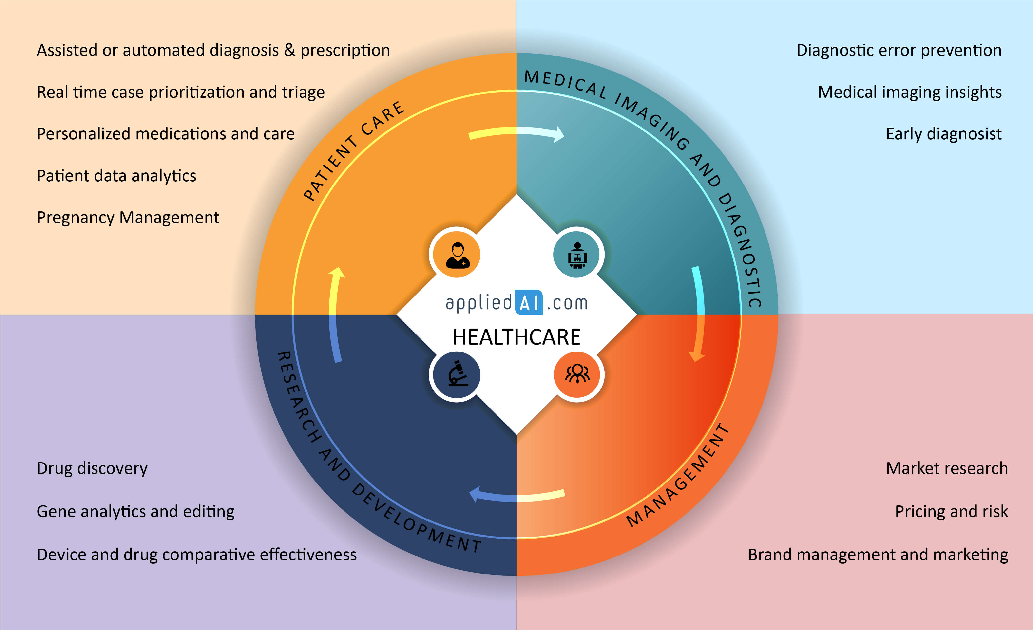
Role of Data Analytics in Healthcare

Slide 3
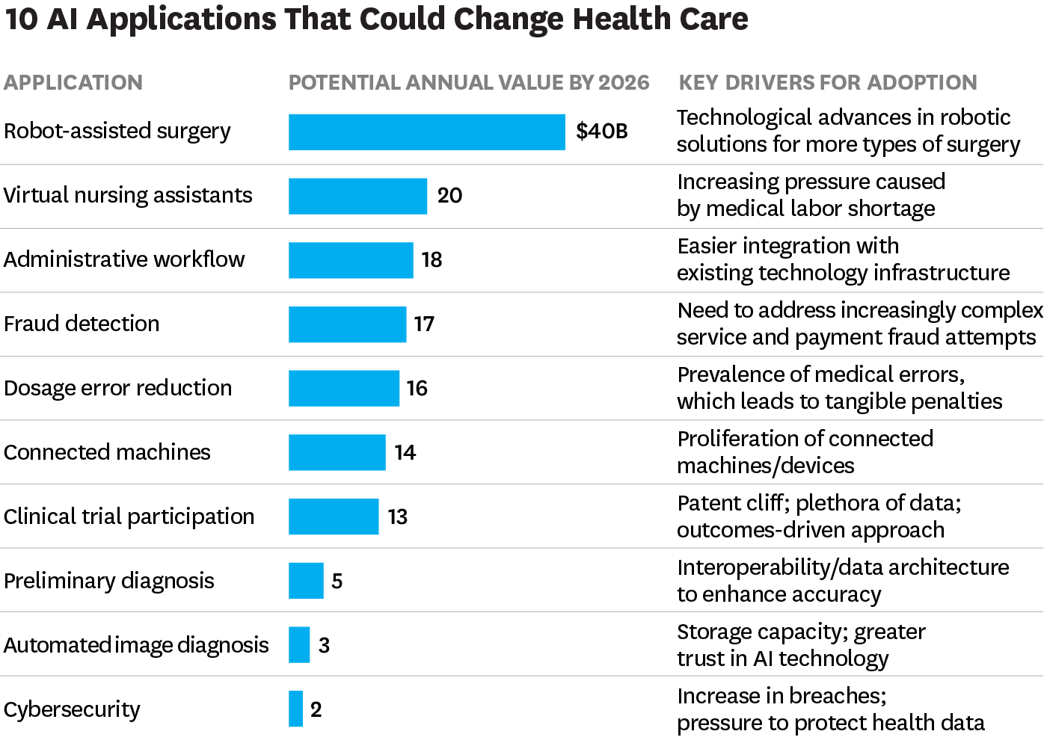

Slide 4
Execution Summary
Descriptive Statistics
Univariate Analysis
Bivariate Analysis
Multivariate Analysis
Statistical Analysis
Observation & Inferences
Classification
Logistic Regression
K Nearest Neighbors
Decision Tree
Random Forest
Grid Search
K fold
Feature Engineering
Model Evaluation
Data Preparation
Exploratory Data Analysis
Model Building
Missing/Null value treatment
Outlier detection and treatment
Imbalanced data treatment
Correction of inconsistent data
Variable Identification
Feature Transformation
Feature Scaling
Feature Selection
Feature Creation
Classification Evaluation Metrics
Overfit or Underfit

Slide 5
Data Set Information
Attribute | Description
Diagnosis | ICD-10 codes for primary and secondary as well multiple tumours if any
FVC | Amount of air which can be forcibly exhaled from the lungs after taking the deepest breath possible
FEV1 | Volume that has been exhaled at the end of the first second of forced expiration
Performance | Performance status on Zubrod scale, Good (0) to Poor (2)
Pain | Pain before surgery (T = 1, F = 0)
Haemoptysis | Coughing up blood, before surgery (T = 1, F = 0)
Dyspnoea | Difficulty or laboured breathing, before surgery (T = 1, F = 0)
Cough | Symptoms of Coughing, before surgery (T = 1, F = 0)
Weakness | Weakness, before surgery (T = 1, F = 0)
Tumour Size | T in clinical TNM - size of the original tumour, 1 (smallest) to 4 (largest)
Diabetes Mellitus | Type 2 diabetes mellitus (T = 1, F = 0)
MI_6mo | Myocardial infarction (Heart Attack), up to 6 months prior(T = 1, F = 0)
PAD | Peripheral arterial diseases (T = 1, F = 0)
Smoking | Patient smoked (T = 1, F = 0)
Asthma | Patient has asthma (T = 1, F = 0)
Age | Age at surgery
Death_1yr | 1 year survival period - (T) value if died (T = 1, F = 0)
The data was collected retrospectively at Wroclaw Thoracic Surgery Centre for patients who underwent major lung resections for primary lung cancer in the years 2007-2011.
The Centre is associated with the Department of Thoracic Surgery of the Medical University of Wroclaw and Lower-Silesian Centre for Pulmonary Diseases, Poland, while the research database constitutes a part of the National Lung Cancer Registry, administered by the Institute of Tuberculosis and Pulmonary Diseases in Warsaw, Poland.

Slide 6
Data Preparation
Missing Value Treatment
Outlier Detection and Correction
Imbalanced Data Treatment
Last Vital Step – Variable Identification

Slide 7
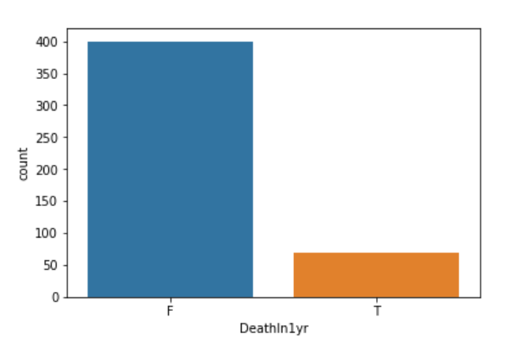
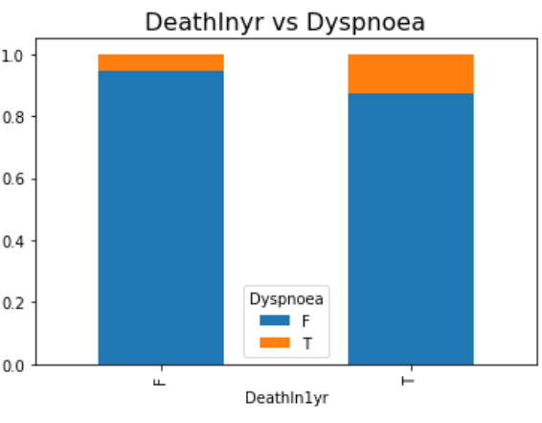
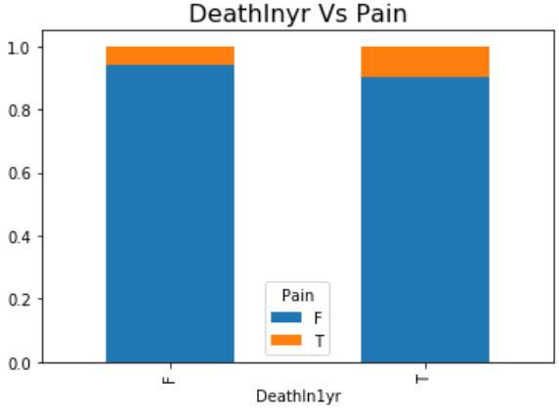
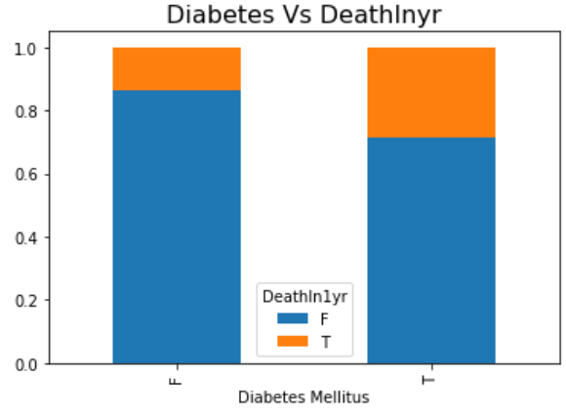
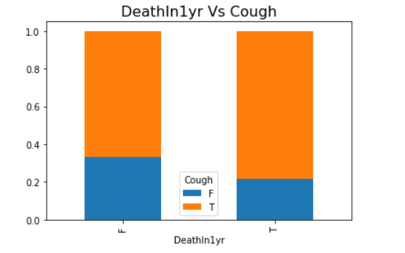
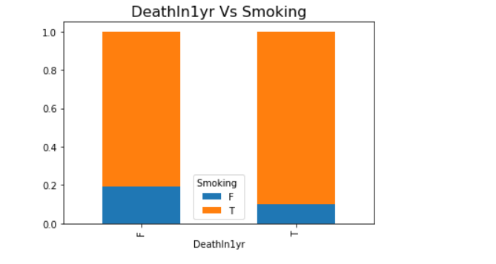
Exploratory Data Analysis
85% survived 1 year and 15% died within a year.

Slide 8
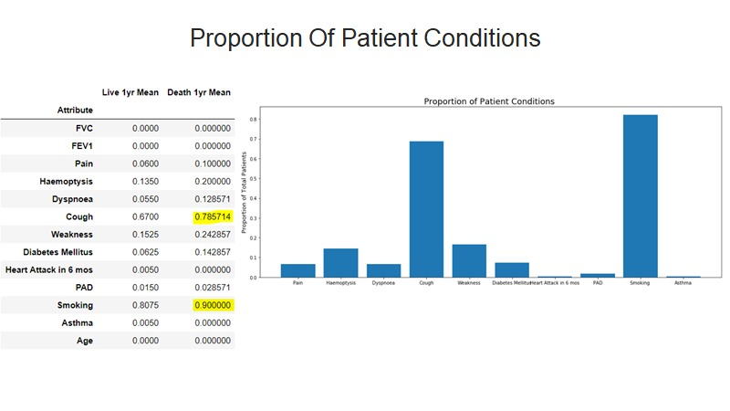

Slide 9
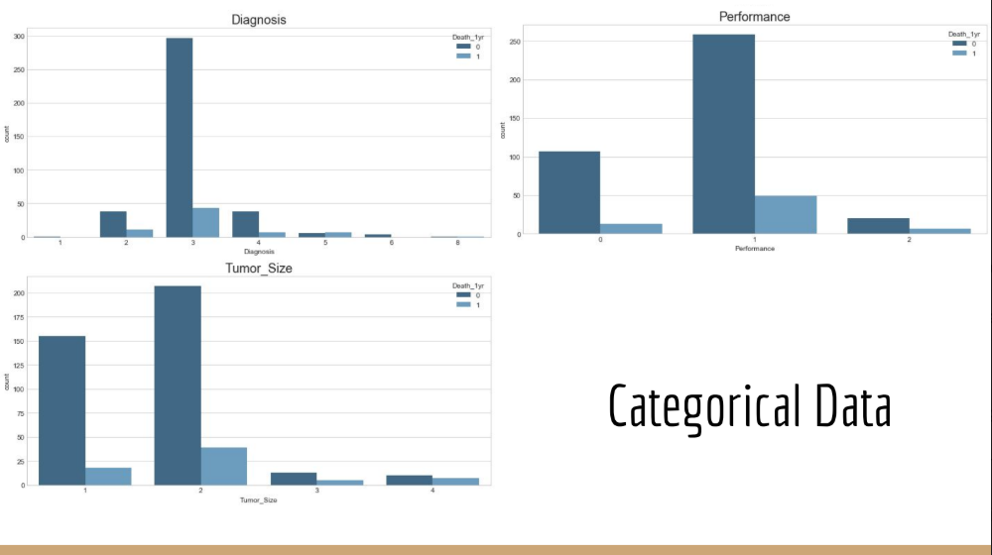

Slide 10
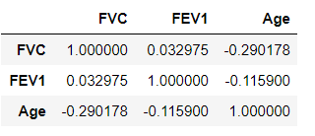
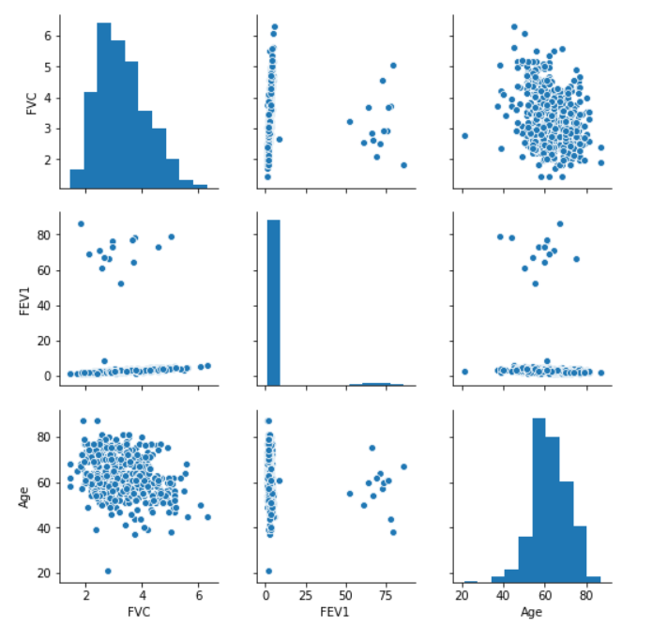
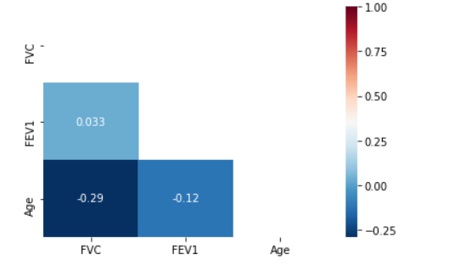
Correlations of Numerical (Age, FVC, FEV1) Data

Slide 11
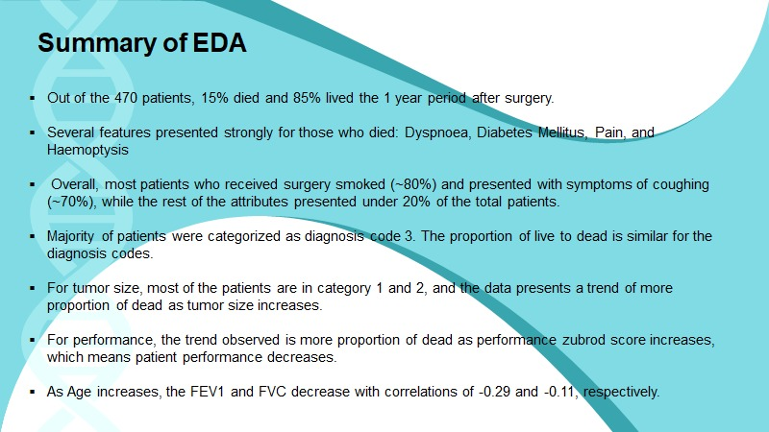

Slide 12
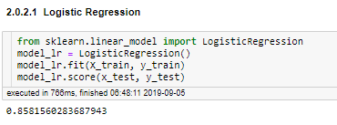
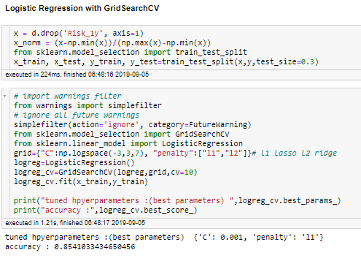
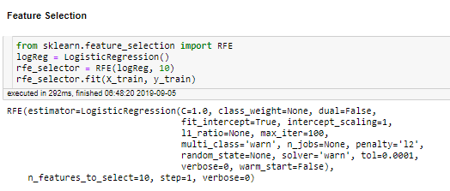
Model Building
Logistic Regression
Model Name | Text
Logistic regression – Normal | 85.81
Logistic Regression – l1 | 85.41
Logistic Regression – l2 | 84.39
Simplest model of classification models.
With Grid Search l1 & l2 regularization
With Recursive Feature Elimination

Slide 13
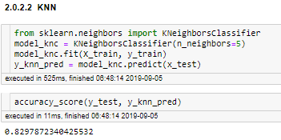
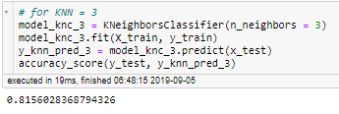
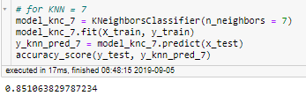
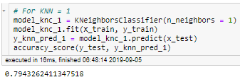
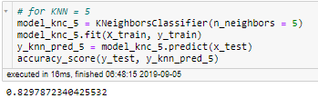
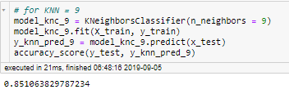
K Nearest Neighbors
Model Name | Accuracy Score
K = 1 | 79.43
K = 3 | 81.56
K = 5 | 82.90
K = 7 | 85.10
Instance based Learning
Cost of Computation is High

Slide 14

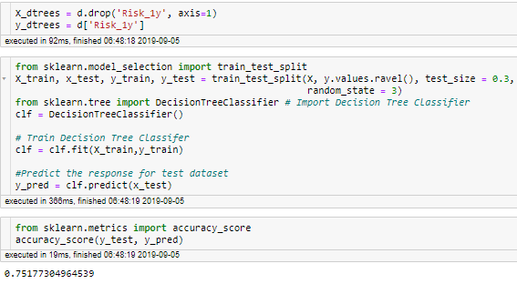
Decision Tree
Model Name | Accuracy Score
Decision Tree | 75.10
Decision Tree
Consists tree like structure
Algorithm that only contains conditional control statements.

Slide 15
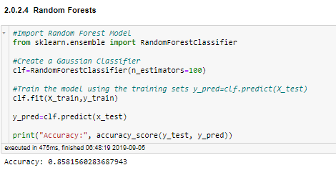
K Nearest Neighbors
Random Forest
Model Name | Accuracy Score
Random Forest | 85.81
It’s One of Ensemble Techniques
More Time Complexity.
Generally considered as Overfit. In our case, relatively less accuracy.

Slide 16


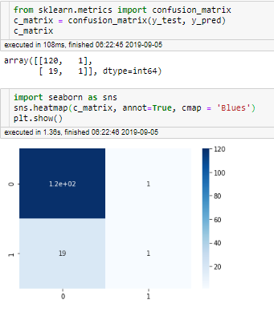
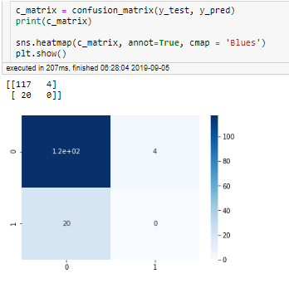
Model Evaluation
Logistic Regression

Slide 17
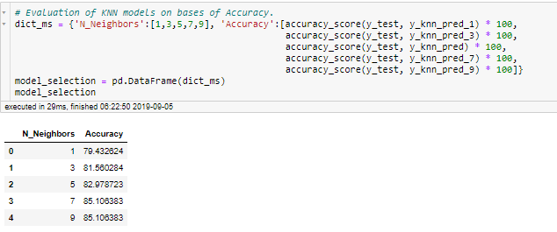
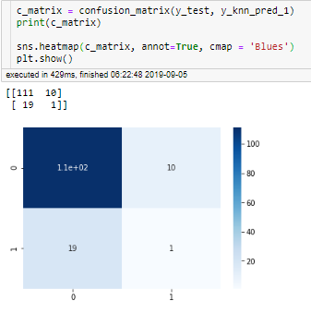
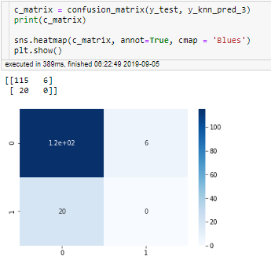
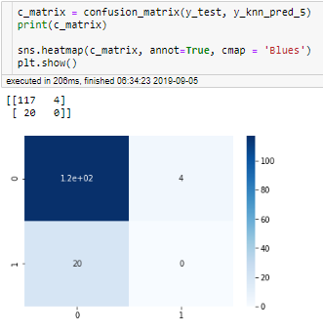
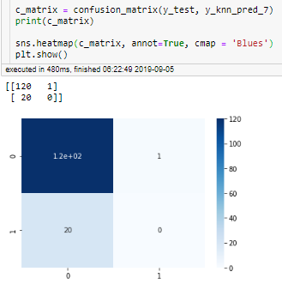
K Nearest Neighbors

Slide 18
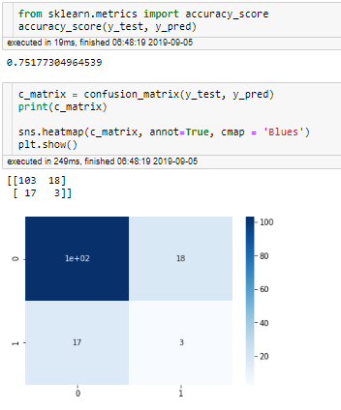
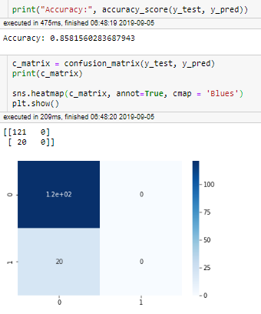
Decision Tree
Random Forest

Slide 19
Best Model Selection
 | Logistic Regression | K Nearest Neighbours | Decision Tree | Random Forest
Model 1 | Acc:85.81, Tp:120, Tn:1, Fp:19, Fn:1 | Acc:79.43, Tp:111, Tn:1, Fp:19, Fn:10 | Acc:75.10, Tp:103, Tn:3, Fp:17, Fn:18 | Acc:85.81, Tp:121, Tn:0, Fp:20, Fn:0
Model 2 | Acc:85.81, Tp:120, Tn:1, Fp:19, Fn:1 | Acc:81.56, Tp:115, Tn:0, Fp:20, Fn:6
Model 3 | Acc:85.41, Tp:119, Tn:1, Fp:20, Fn:2 | Acc:82.90, Tp:117, Tn:0, Fp:20, Fn:4
Model 4 | Acc:84.39, Tp:117, Tn:0, Fp:22, Fn:2 | Acc:85.10, Tp:120, Tn:0, Fp:20, Fn:1
Model 5 |  | Acc:,85.10 Tp:120, Tn:0, Fp:20, Fn:1
Logistic Regression
K Nearest Neighbours
Decision Tree
Random Forest
Simplest model of classification models.
Instance based Learning
Cost of Computation is High
Consists tree like structure
Algorithm that only contains conditional control statements.
It’s One of Ensemble Techniques
More Time Complexity.
Generally considered as Overfit. In our case, relatively less accuracy.

Slide 20
Conclusion
First, more data will improve the scope of the data analysis and models
From analysis of this data set, it is clear that there are significant overlaps of attributes, so more patient data or perhaps creating a new data set with additional attributes could help better distinguish the differences and improve the model. If not new data recordings, there are probably similar data sets that have models that predict lung cancer deaths that could be of use in optimizing this model by using it in combination.
Finally, depending on the desired outcome considering false prediction costs, the models can be used in an ensemble method to maximize the outcome desired.
the desired outcome will depend on the hospital or client and how they view the detriment of giving false positives and false negatives compared to the true predictions for live or death outcomes for patients; in other words, how they want to score the efficiency of the model.

